Slide 1
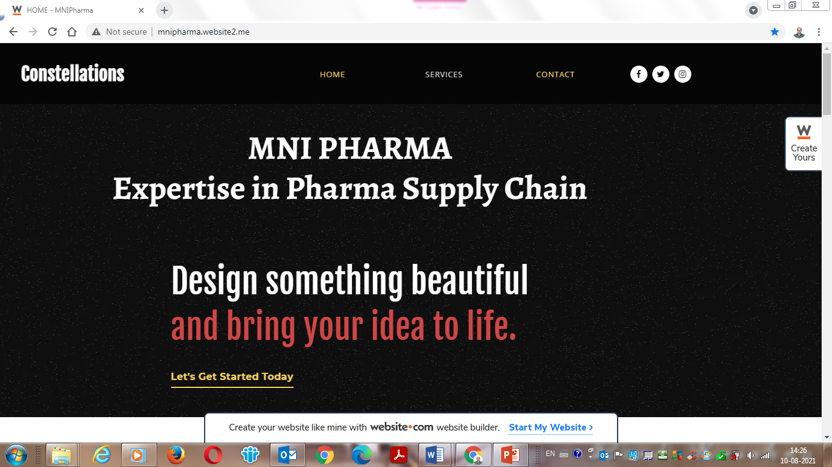
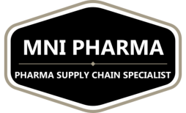

Slide 2
A Complete Package
MNI Pharma offers Expert Consultancy Services in the Area of Pharmaceutical Supply Chain Management encompassing both Direct Materials (Raw Materials) and Indirect Materials (Capital & MRO) for both API and Formulation Manufacturers.
Services offered include Procurement Strategy and Problem Solving, Leadership and Supply Chain Organization Structure, Data Analytics, Category Management, Negotiation Techniques, Guidelines to Clean sheet costing and TCO (Total Cost of Ownership), Implementation Guidelines for flawless execution, Smart Sourcing and Cost Optimization, and Institutionalization of Good Practices.

Slide 4
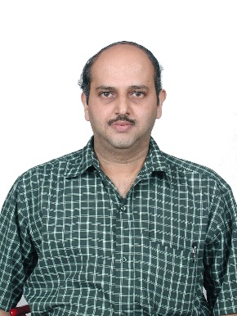
MNI PHARMA
Expertise in Pharma Supply Chain
FIELD AND SCOPE OF OPERATION :GLOBAL PHARMA
SERVICES PROVIDED ACROSS THE GLOBE
PHYSICAL OFFICES:LOCATED IN INDIA:HYDERABAD, BANGALORE AND CHENNAI
CORPORATE OFFICE : AMEERPET, HYDERABAD
CONTACT DETAILS
Mobile No: 9391393813
Email id : madhavaniyengar59@gmail.com

Slide 5
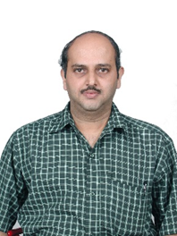
Madhavan N Iyengar (Managing Director & CEO of MNI Pharma) is a Chemical Engineer with a Master’s in Financial Management and over 35 years of experience in Projects and Supply Chain Management.
Worked in EPC Projects in various Industries (Amar Dye Chem, Indofil Chemicals, Kvaerner Power Gas and Saipem)
Worked in Supply Chain Management in the Sanmar Group and with Dr Reddys Laboratories
Last worked in Dr Reddys Laboratories from 2005 to 2019 and handled multiple roles in Direct and Indirect Procurement for API, Oncology, Biologics and Formulations. Last held position (prior to starting of MNI Pharma in April 2019) : Head Indirect Procurement for API and Formulations at Dr Reddys Laboratories.

